Slide 1
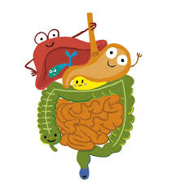
The Gastrointestinal System
Mustafa AL-Badran
CABM( Medicine)
FIBMS (Rheumatology)

Slide 2
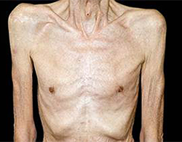
Anorexia & Weight Loss
Anorexia is loss of appetite
Weight loss occurs when energy expenditure exceeds calorie intake
Weight loss is common in
Malignancies of the upper gastrointestinal tract (cancer cachexia (
Inflammatory gastrointestinal disorders, e.g. Pancreatitis or inflammatory bowel disease
Chronic liver disease
Notes:
Clinically significant weight loss about 5% of body weight over 6 to 12 month

Slide 3
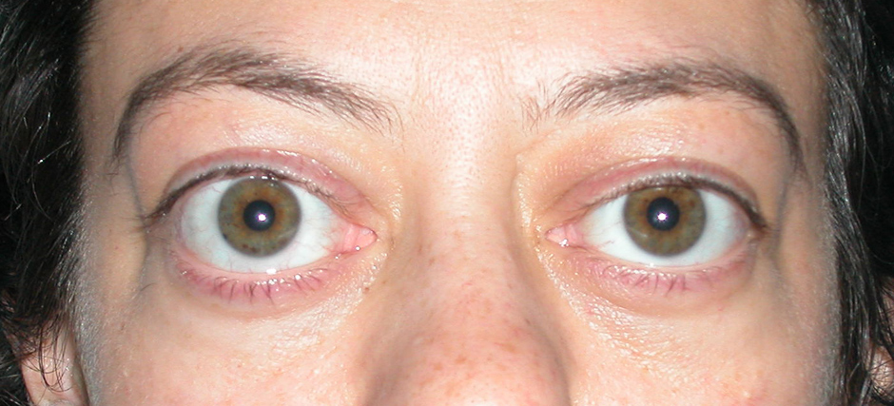
Weight loss with normal, or even increased, calorie intake is rare, but may occur in
Type 1 diabetes mellitus
Hyperthyroidism
Malabsorption
Fever

Slide 4
Very rapid weight loss (> 0.5 kg/day) invariably indicates fluid loss, and causes include
Diuretic therapy
Severe diarrhoea
Vomiting
Severe burns

Slide 5
Dysphagia
Dysphagia is difficulty swallowing and should always be investigated
Dysphagia may be caused by
Oral diseases (painful mouth ulcers, mouth or throat infections, ill-fitting dentures)
Brain stem (cerebrovascular accidents): typically worse for liquids than for solids, and may be accompanied by choking and throwing up of fluid from the nose
Esophagus (benign stricture, cancer)

Slide 6
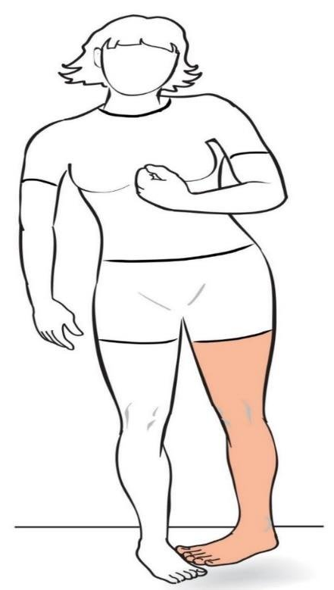
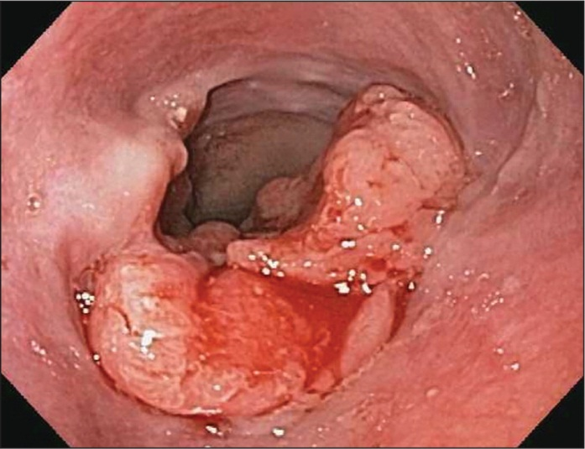

Slide 7
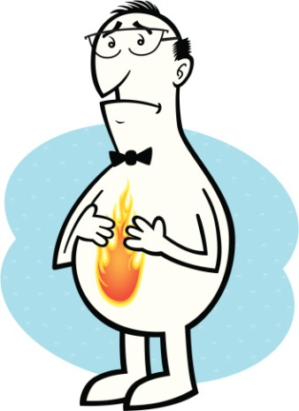
Heartburn
Heartburn is a hot, burning retrosternal discomfort which radiates upwards→ Gastro-oesophageal reflux disease
Its occurrence on lying flat or bending forward help to differentiate it from retrosternal ischaemic chest pain

Slide 8
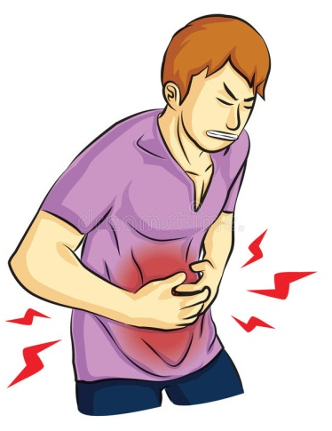
DYSPEPSIA
Pain or discomfort centered in the upper abdomen
Dyspepsia is often used to encompass
Gastro-oesophageal reflux disease
Peptic ulcer disease
Non-ulcer or functional dyspepsia
Dyspepsia is very common, affecting up to 80% of the population at some time in their lives

Slide 9
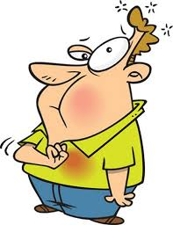
Notes
Note 1: Pain which is worse with an empty stomach and eased by eating is the classical peptic ulcer description
Note 2: 'Fat intolerance' is common to all causes of dyspepsia and does not specifically suggest gall bladder disease

Slide 10
Nausea & Vomiting
Nausea is the sensation of feeling sick
Vomiting is the expulsion of gastric contents via the mouth
Both are often associated with the autonomic features of pallor, sweating & hyperventilation

Slide 11
Vomiting occurs
Gastrointestinal disorders, e.g. GE, Cholecystitis, Pancreatitis and Hepatitis (vomiting is preceded by nausea)
Raised intracranial pressure (Vomiting is not preceded by nausea)
Vomiting may be caused by severe pain, e.g. Renal or biliary colic, myocardial infarction
Metabolic disorders e.g. DKA ,Uraemia
Drug therapy e.g. Opioids, Cytotoxic agents

Slide 12
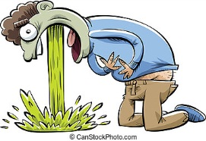
Notes
Note 1: Gastric outlet obstruction causes projectile vomiting of large volumes of gastric content which is not bile stained
Note 2: Obstruction distal to the pylorus produces bile-stained (green) vomit
Note 3: The more distal intestinal obstruction, the more marked are the accompanying symptoms of abdominal distension and intestinal colic

Slide 13
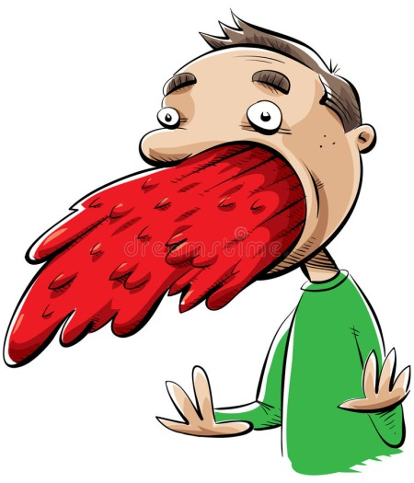
HAEMATEMESIS
Haematemesis is vomiting blood
Fresh and red
Degraded by gastric pepsin, when it is dark in colour and resembles 'coffee grounds'.
If the source of bleeding is above the gastro-oesophageal sphincter, e.g. from oesophageal varices, fresh blood wells up in the mouth rather than being actively vomited
A lower oesophageal (Mallory-Weiss) the patient vomits forcefully several times; fresh blood only appears after the initial vomit

Slide 14
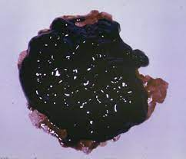

Slide 16
Causes of Haematemesis e.g.
Gastric ulcer
Duodenal ulcer
Oesophago-gastric varices
Mallory-Weiss tear
Note: Cancers of the stomach or the esophagus rarely present with haematemesis

Slide 20
Abdominal Pain
Visceral pain (autonomic innervation T5-L2) results from
Distension of hollow organs
Mesenteric traction
Excessive smooth muscle contraction
Visceral pain is experienced as a deep poorly localized sensation in the midline

Slide 21
Somatic pain (innervated by the intercostal (spinal) nerves ) is caused by Irritation of the parietal peritoneum
Somatic pain is localized to the area of inflammation

Slide 24
Notes
Note 1: Pain arising from foregut structures (Stomach, Pancreas, Liver and Biliary system) is localized above the umbilicus
Note 2: Pain arising from the small intestine, e.g. small intestinal obstruction, is felt around the umbilicus (periumbilical)
Note 3: Pain arising Colon is typically felt below the umbilicus

Slide 25
Note 4: Pain from unpaired structures such as the pancreas is usually felt in the midline and radiates through to the back
Note 5: Pain from paired structures usually felt on the affected side e.g. renal colic pain classically radiates from the flank into the groin

Slide 26
WIND
Patients may call
Repeated belching
Excessive or offensive rectal flatus
Abdominal distension
Borborygmi (audible bowel sounds)
Wind

Slide 27
Belching may result from air swallowing (aerophagy) and is usually of no major significance. It may indicate anxiety
The normal volume of flatus passed per rectum varies from 200-2000 ml per day
It is a mixture of gases derived from swallowed air and from colonic bacterial fermentation of poorly absorbed carbohydrates

Slide 28
Causes of Excessive flatus
Lactase deficiency
Malabsorption
The inability to pass flatus is a feature of intestinal obstruction
Borborygmi result from the movement of fluid and gas along the bowel usually just a source of embarrassment

Slide 29
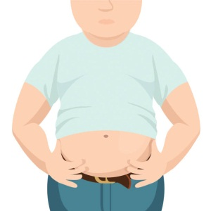
Abdominal Distension
Five Fs
Fat
Fluid
Flatus
Faeces
Fetus
The principal causes of abdominal distension are

Slide 30
Abdominal girth increasing slowly over months or years is usually due to obesity
If it occurs in a patient who is losing weight it suggests intra-abdominal disease

Slide 31
Ascites
Accumulation of fluid in the peritoneal cavity

Slide 32
Causes of Ascites
Common
Hepatic cirrhosis with portal hypertension
Intra-abdominal malignancy with peritoneal spread
Less common
Nephrotic syndrome
Right heart failure
Constrictive pericarditis
Rare
Budd-Chiari syndrome (Hepatic venous obstruction)
Tuberculous peritonitis
Hypoproteinaemia, e.g. protein-losing enteropathy, severe malnutrition

Slide 33
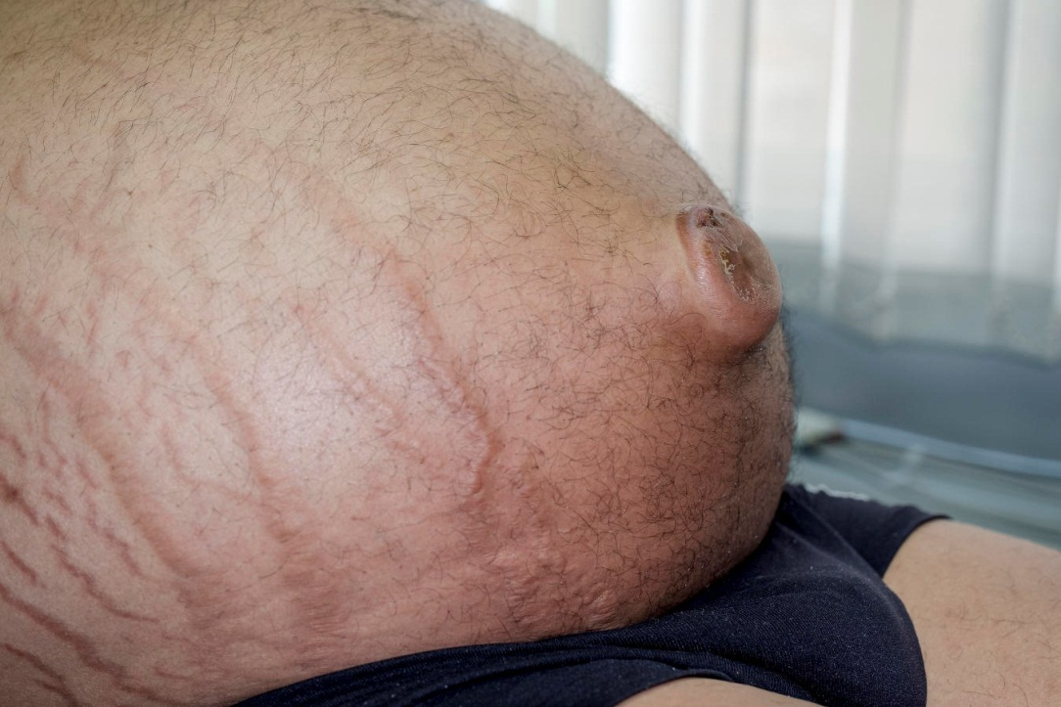

Slide 34
Altered Bowel Habit
Normal bowel movement frequency can be from three times each day to once every three days.
Diarrhoea is the frequent passage of loose stools
Constipation is the infrequent passage of hard stools

Slide 35
Diarrhoea may be
High Volume diarrhoea (> 200 g stool/day or > 1 liter per day) occurs when the water content of the stool is increased & divided into:
Secretory, due to intestinal inflammation, e.g. viral or bacterial infection, ulcerative colitis or Cohn’s disease
Osmotic, due to malabsorption, drugs or motility disorders
Low volume diarrhoea :The commonest cause of low-volume diarrhoea is irritable bowel syndrome

Slide 36
Causes of Constipation
Lack of fibre in diet
Irritable bowel syndrome
Intestinal obstruction (cancer)
Metabolic/endocrine (hypothyroidism, hypercalcaemia)
Drugs (Opioids, Iron)
Immobility (Stroke, Parkinson's disease)

Slide 38
Rectal Bleeding
Fresh rectal bleeding indicates a disorder in the anal canal, rectum or colon; Blood may be
Mixed with the stool
Coat the surface of otherwise normal stool
Seen on the toilet paper
Melaena is the passage of black, tarry stools with a characteristic odour signifying blood loss in the upper gastrointestinal tract

Slide 39
